Slide 1
Teleradiology
LIS4776: Health IT 3/04/24
Dr. Christina Eldredge
Daiyana Z. – Technical Advisor
Luis B. — Cybersecurity Specialist
Makayla H.–Outcome Specialist
Melinda P. – Financial Advisor
Gian G. – Team Leader

Slide 2
Table of Contents
Introduction
Triple/Quadruple Aim
Case Study #1-3
Teleradiology Company #1-2
Differences within Teleradiology Companies
Why We Chose Infinity Teleradiology
Financial Evaluation
Privacy and Cybersecurity in Teleradiology
Protecting Patient Data
Ensuring Security and Trust
Usability Factors in Teleradiology
User-Centered Design and Continuous Improvement
Outcomes Measured
Conclusion
References

Slide 3

Introduction
Standalone ER is facing radiologist shortages
Patient Satisfaction is low
Radiologist Burnout is high
Administrative staff wants to implement Teleradiology to combat their problems
Notes:
A standalone emergency room has been combating the national radiologist shortages. This problem has led patients to voice their frustrations online about long wait times and slow services. Patients are not the only ones to voice their dissatisfaction. Radiologists at the emergency room have had an all-time high of burnout and stress. The administration at the emergency room has done their research and have decided to incorporate a solution that addresses the triple and quadruple aims of the healthcare approach. They concluded on implementing teleradiology, a remote service that can process images taken at the facility. This plan aims to address Population Health, Patient Experience of Care, Health Care Provider Experience , and Employee Experience and Health

Slide 4
Triple/Quadruple Aims
Triple Aim
  Improving Population Health
  Improving Patient Experience of Care
Quadruple Aim
  Improving Health Care Provider Experience
  Improving Employee Experience and Health
Notes:
When looking at the triple and quadruple aims, we first need to see which aspects we are focusing to correct and solve. In regard to triple aim, the administrative team plans to use teleradiology to improve population health and patient experience of care. This would be done by teleradiology providing fast imaging processing. This faster imaging will increase patient of care by allowing the emergency room to help more patients but also validify diagnosis, due to multiple health professionals working on the imaging and processing. After tackling the triple aim, we go into the quadruple aim, planning on improving health care provider experience and employee experience and health. Because teleradiology can connect physicians to remote radiologists, different perspectives can give insight on a certain diagnosis, for example, a teleradiologist able to spot a symptom that is common in their area. Moreover, employee experience and health would be positivelty effected, reliving stress for radiologists working on-site, reducing human error.

Slide 5
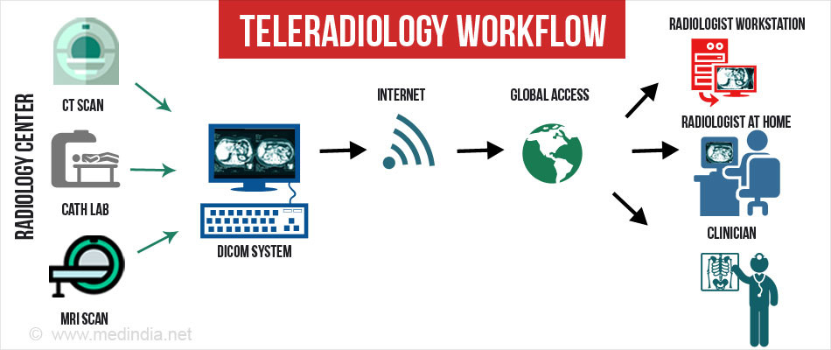
Example of Teleradiology Workflow

Slide 6

Case Study #1
24-hour Onboard Hospital (cruise ship) (Henes et al., 2020)
  Secure data transfer through use of VPN's
  Equipped with a mobile radiography unit and digital storage imaging plates
Outcomes:
  Turnaround time: ~30 minutes
  47 Successful transmissions
  High-standard interpretation of radiographs
Notes:
There have been several cases and studies where the effects of teleradiology implementation have been observed. In the first study we will be looking at, a cruise ship was involved in a pilot study, where the ship was equipped with a mobile radiography unit to introduce a 24 hour teleradiology service. In addition to the mobile unit, it also featured digital storage imaging plates and through the use of a virtual private network, or VPN, radiographs were securely transferred. With this service they reported a turnaround time of about 30 minutes which showed that timely care is achievable with this service. Out of 47 total radiography transmitted images, all of them were transferred with no delay, which is important to note because the data infrastructure was stable enough to support this service. Based on the American College of Radiology Task Force recommendations for Teleradiology Practice ​a high-standard interpretation of radiographs was developed in accordance.

Slide 7
Case Study #2
Kaiser Permanente Southern California medical centers (Horn et al., 2006)
  Web application used to monitor workflow and provide reports
  Quality monitoring system
Outcomes:
  High clinician satisfaction with responsiveness
  19 minutes between examination and "wet read"
  Decrease in delays of after-hour interpretations
  Reduction of "callbacks"
Notes:
The second study we will be looking at is the after hours teleradiology that Kaiser Permanente Southern California, or KPSC, implemented in their hospitals in order to support their staff. A feature of this service is that it uses a web application in order to manage the workflow that comes along with teleradiology exams and to provide reports to referring clinicians. This service also includes a quality monitoring system that tracks any significant discrepancies between the teleradiologists’ findings and the final reports of a medical center’s staff radiologist. Clinicians who have utilized the KPSC teleradiology service have been reported to be highly satisfied with responsiveness of the technology, and the median time between the performance of an exam and availability of a wet read has decreased to 19 minutes. Along with an improved timeliness, the KPSC teleradiology service has significantly decreased the delays in providing after-hours interpretation of CT, MRI, and ultrasound exams, as well as a reduction in “callbacks” resulting in an improved quality of life for the radiologists.

Slide 8
Case Study #3
Rural Arizona Hospitals connecting to University of Arizona’s Telemedicine Department (Krupiński & Hopper, 1997)
  IBM compatible capture and send workstation
  50-micron spots size digitizer
Outcomes:
  85% of images in 41 cases deemed good quality
  95% of diagnostics returned in timely manner
  Reduced cost of high-quality care for patients
Triple Aim Outcomes Achieved: | Quadruple Aim Outcomes Achieved:
Improving Patient Experience of Care | Improving Health Care Provider Experience
Notes:
In this third case, the goal of this project was to evaluate the overall use and effectiveness of the teleradiology system that was linked to the Department of Radiology at the University of Arizona with a rural hospital 100 miles away. The rural hospital installed a IBM compatible capture and send workstation with a 50-micron spots size digitizer. 95 percent of the imaging sessions were judged to be successful overall in terms of speed and diagnostic accuracy and 83 percent of the time, the correct type and number of images were sent to reach a diagnosis. The current teleradiology system provides a much needed high quality service to a rural population of patients.

Slide 9

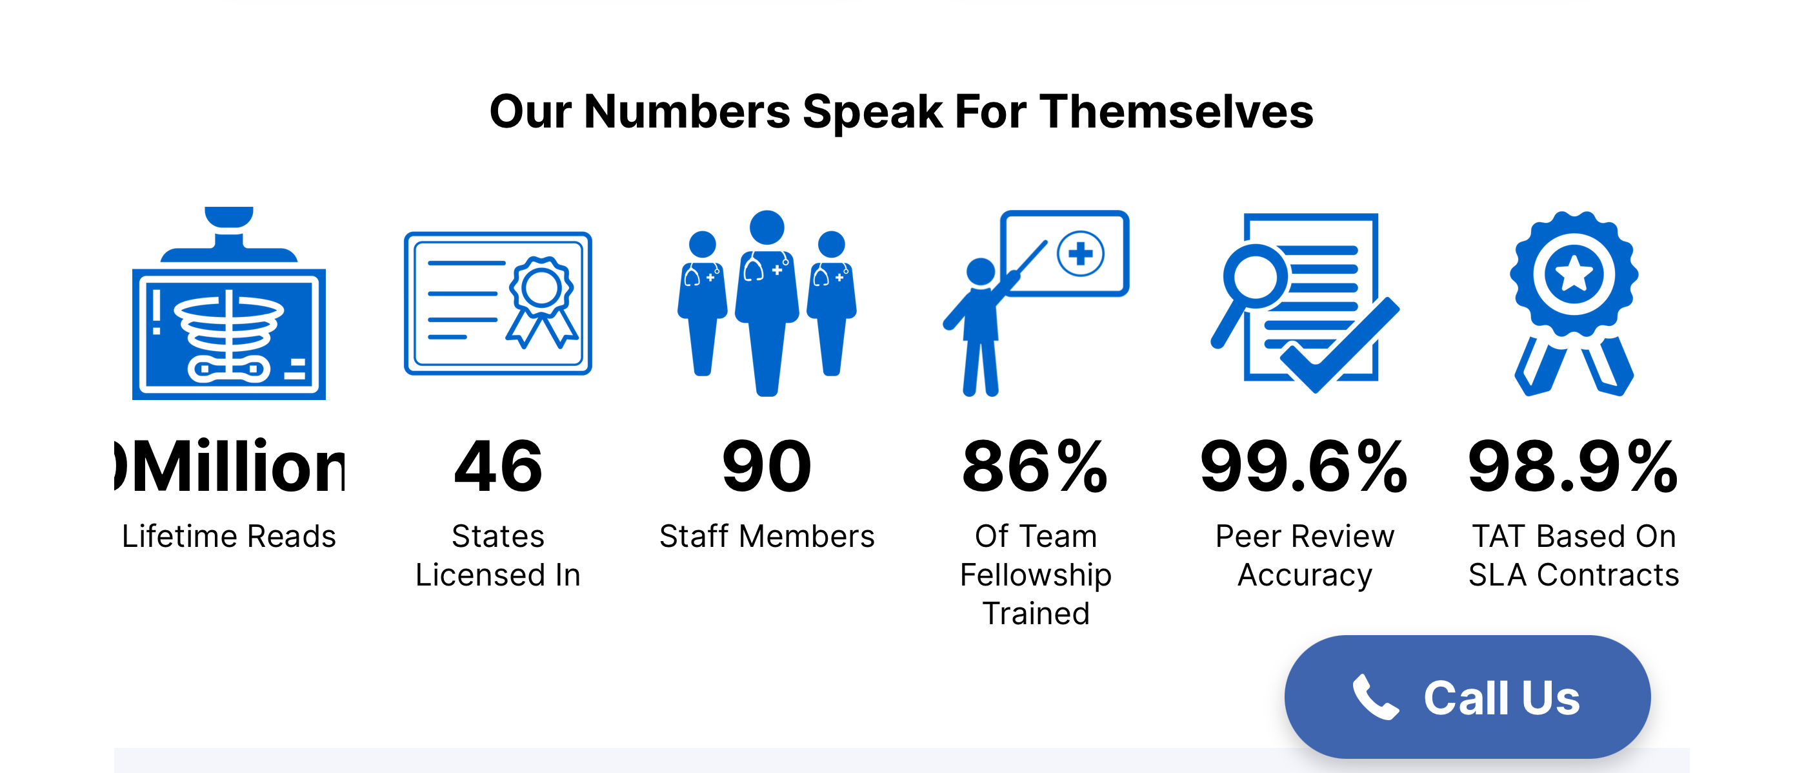
Teleradiology Company #1
Infinity Teleradiology
  Company's goal is to supply imaging solutions that satisfies provider and patient needs. They aim to always improve their technology and continue to give the best imaging in health care history.
  Services provided to meet customer needs:
    Mammograms, x-rays, CT-scans, nuclear medicine
    Concierge Interpretation
    Sub-Specialty Radiology Services
    IT Solutions such as Radiology Interpretive Services, Teleradiology Customizable PACS , Credentialing and State Licensing, Compliance and Practice Management
    Billing w/ rates and payment plans and IT solutions

Slide 10

Teleradiology Company #2
Night Hawk Radiology
  Devoted to providing quality service at reduced cost 24/7
    Emergency
    Musculoskeletal
    Pediatric
    Telecardiology
    Body imaging
      Mammograms
      Neuro

Slide 11
Differences within each Teleradiology Company
Infinity
The only way you will be able to know more and see exactly what the company provides is by proceeding to receive a quote. However, compared to Night Hawk they have teleradiology services that most companies do not provide all at once and certain rates. Company is a little private which can also ensure no HIPPA violations.
  Top Company for most radiologist. Has different variations of the company providing different forms of telehealth
  99.6% peer review accuracy rate for their technology with a limited number of licensed physicians
  Trained physicians' part of clinical, evidenced based work and/or studies to better patient and care giver relations and trust in technology.
  Provides Most services most teleradiology companies do not
  Turn-around time is at most 24 hours
  EHR
Night Hawk
Company emphasizes helping other companies and patients at all time. Their website has a very in-depth explanation of each service and what it provides exactly. Technology here has been continuously developed since 1999.
  Open company for business and patients themselves.
  Insurances quotes and legal quotes available for works compensation and other injury related situations
  Legal quotes available
  Turnaround time is "fast" but not specified
  EMR

Slide 12
Why We Chose Infinity Teleradiology
Night Hawk was a company more tailored as a private institute
  More services concerning legality and insurances
Teleradiology has a better success rate as well as additional services
Notes:
Night Hawk was a company more tailored as a private institute for radiology, having legal services and insurance brokers for work-related injuries. This, in comparison to Infinity Teleradiology, is night and day. Infinity Teleradiology has a better success rate as well as additional services, like mammograms, ct-scans, and nuclear medicine. They also had concierge interpretation, which can work in support with on-sight radiologists. With this in mind, Infinity Teleradiology was the clear winner in emergency room situations when health professionals do not know what injuries they will face.
Mammograms, x-rays, CT-scans, nuclear medicine
Concierge Interpretation
Sub-Specialty Radiology Services

Slide 13
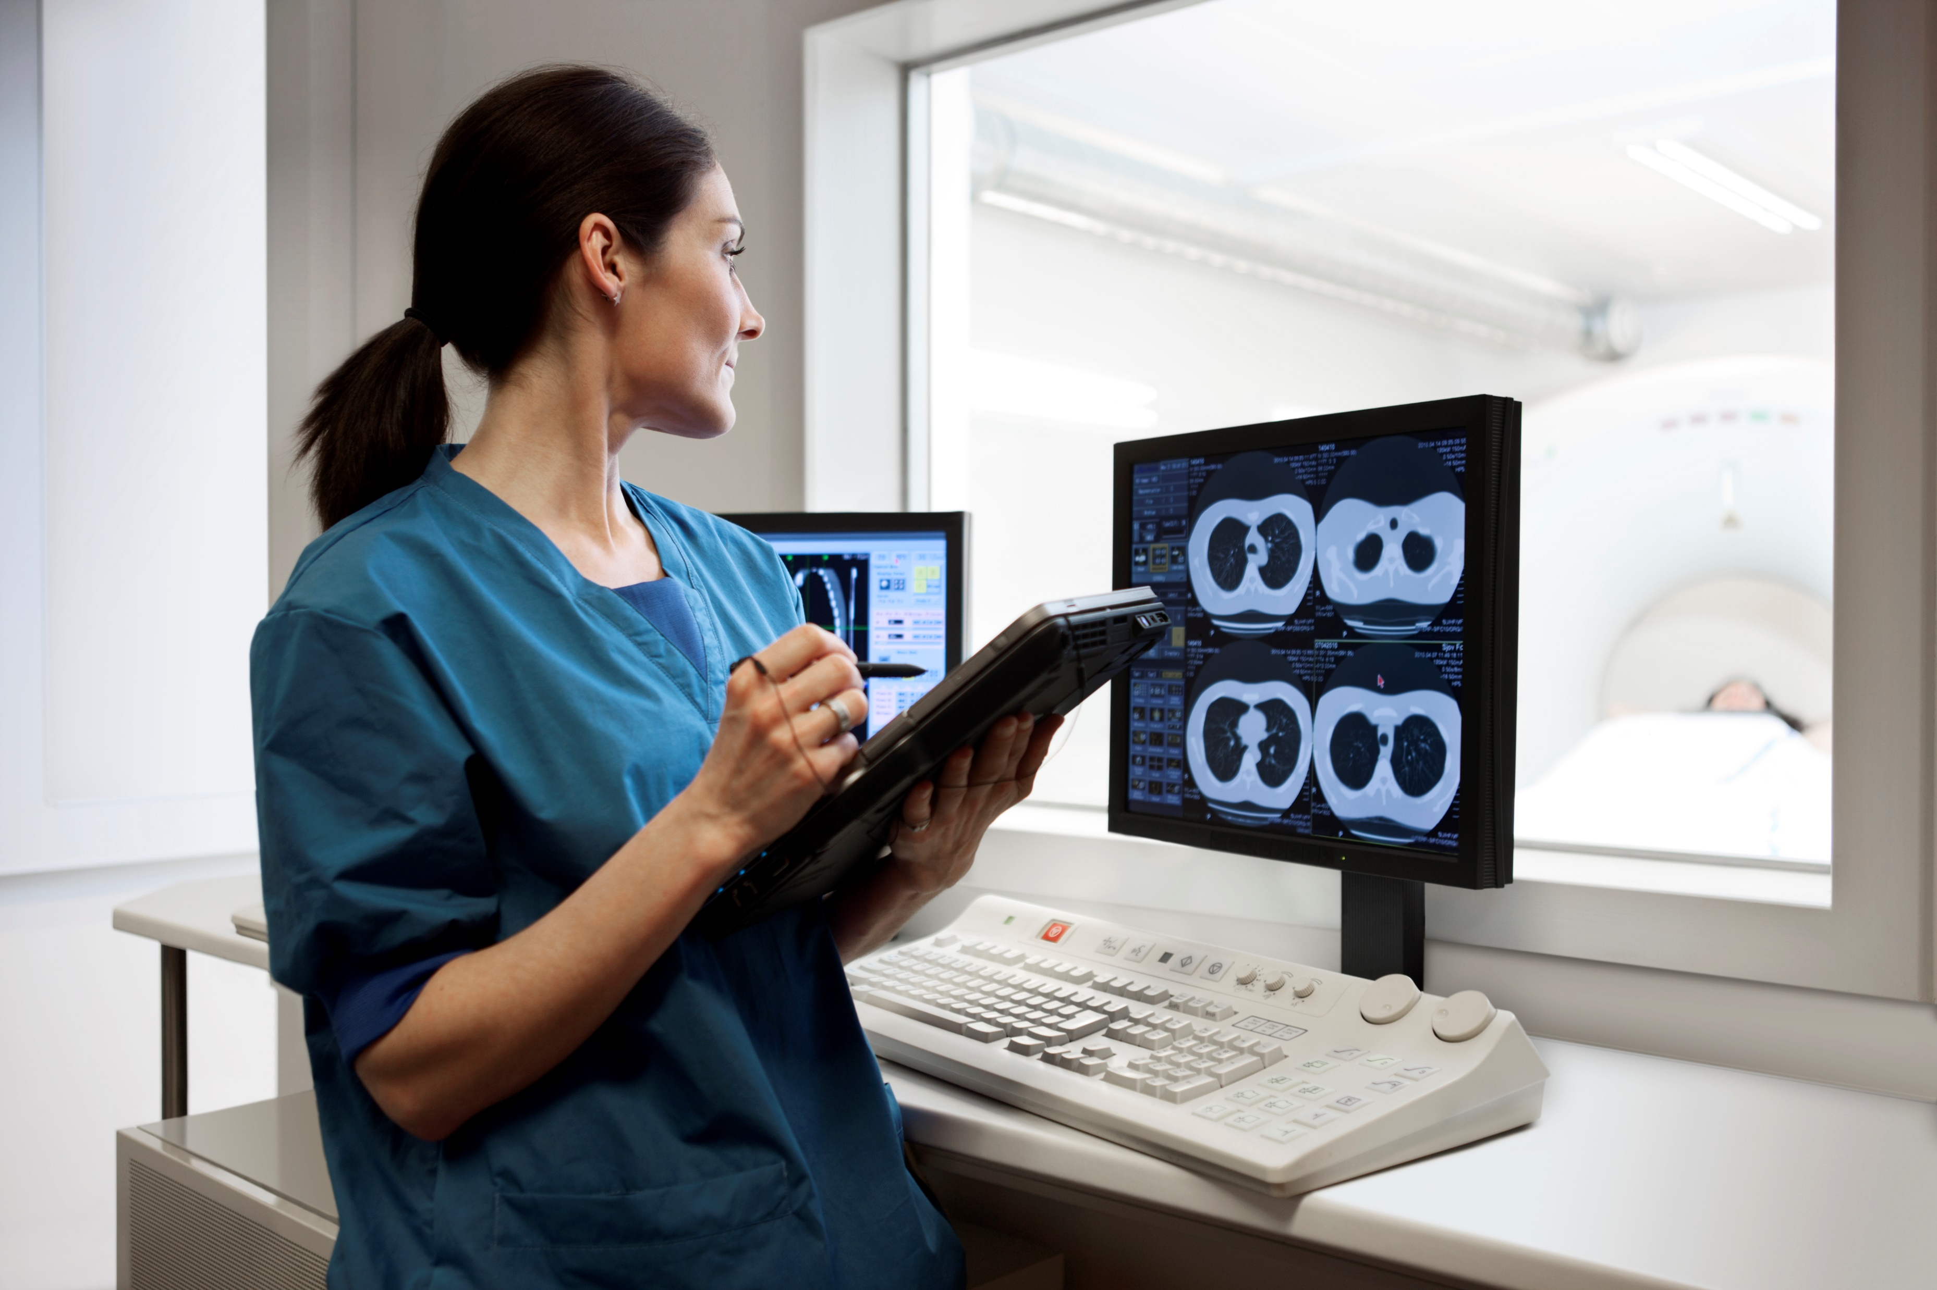
Financial Evaluation
Research
Installation costs
Integration with other systems
Implementation
End-user training
Notes:
Research – minimal due to readily available vendor options and information as well as vendor responsiveness to come to site.
FTEs
Supplies
Travel
Installation costs – again minimal costs of several computer stations either located in a central area of radiology or within each modalities control room.
Infrastructure
Hardware
Software
Integration with other systems – DICOM
Implementation – this system is often set up alongside main control systems with minimal interruption for installation.
Production loss
End-user training - this cost is minimal with usually 15-30 minutes of training per user.
Current and future
FTEs
Materials

Slide 14
Financial Evaluation
Security
Quality assurance
System maintenance
Loss of staff radiologist income
Regulations and liability
Exam | Interpretation Fee/Exam
X-Ray | $11+
US | $25+
CT | $36+
MR | $48+
PET/CT | $75+
Notes:
Security – NEXT too
System maintenance- with optimal choice of vendor and contract options, security concerns would be addressed and costs covered in the paid service as well as system maintenance, updates, and upgrades.
Updates and upgrades
Quality assurance – often, teleradiology services are used as a preliminary reading performed during off-peak hours followed-up with a final interpretation by the staff radiologist upon return to shift.
Loss of staff radiologist income – often with independent radiology groups, the teleradiology reading fees are paid by that group.
- The teleradiology fee structure and rates for final interpretations range from $11 to $75 per study depending on the imaging modality. Modalities include X-Ray, Ultrasound, CT, MRI, PET, PET/CT, MSK, Echocardiogram, Mammography and others.
Regulations and liability

Slide 15
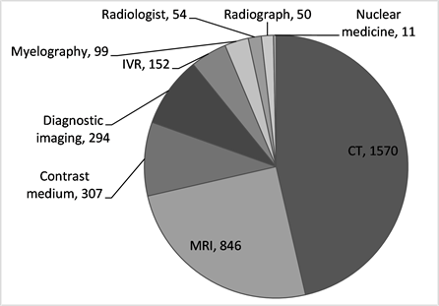
Financial Evaluation
Cost projections of NOT implementing
AARP
  “The ensuing cost of medical misdiagnosis to the U.S. health care system may be as high as $100 billion per year”
Image obtained on 2024-03-02 from: https://www.scirp.org/journal/paperinformation?paperid=85235
Notes:
Cost projections of NOT implementing – The most frequently utilized scenario involves offering diagnostic image interpretation during evening and night shifts for the Emergency Department (ED) and urgent inpatient (IP) services. This facilitates timely and accurate diagnoses to address urgent patient health concerns. Alternatively, assigning image interpretation duties to non-specialists such as ED providers and hospitalists can diminish their productivity. Furthermore, this practice may frequently result in misdiagnoses or delayed diagnoses, posing significant risks to patient care.
https://www.aarp.org/health/conditions-treatments/info-2023/cost-of-wrong-diagnosis.html#:~:text=Costs%20of%20misdiagnosis,%2C%20according%20to%20StatNews.com
https://www.scirp.org/journal/paperinformation?paperid=85235

Slide 16
Privacy and Cybersecurity in Teleradiology
Ensuring patient privacy and cybersecurity within teleradiology is paramount.
Medical imaging data is highly sensitive, and unauthorized access poses significant risks to patient confidentiality and data integrity

Slide 17
Protecting Patient Data
Security measures
(SSL/TLS)
Multifactor Authentication
Following rules is very important, especially in the United States for healthcare organizations. They need to stick to something called the Health Insurance Portability and Accountability Act (HIPAA).

Slide 18
Ensuring Security and Trust
Data protection strategies, including regular data backups and disaster recovery plans, are essential components of teleradiology systems to prevent data loss and mitigate the impact of cybersecurity breaches.
In conclusion, prioritizing privacy and cybersecurity in teleradiology is essential for maintaining patient trust and integrity in healthcare delivery.

Slide 19
Usability Factors in Teleradiology
Usability encompasses efficiency, effectiveness, and user satisfaction.
Streamlined workflows optimize productivity for radiologists.
Intuitive interfaces aid in efficient image interpretation and navigation.

Slide 20
User-Centered Design and Continuous Improvement
Engage radiologists and end-users in design to tailor systems to their needs
Conduct usability testing to identify and address issues early in the development process.
Regular updates ensure systems evolve with user needs and technological advancements.

Slide 21
Outcomes Measured
What will be measured?
Population Health
  Accurate Diagnoses
  Clinical Outcomes
  Patient Satisfaction
Staff Satisfaction
  Work-life Balance
  Staff Burnout
  Assessing satisfaction with teleradiology implementation
Efficiency and Workflow
  Turnaround time
  Number of cases processed
Notes:
We will be looking to measure 3 aspects amongst the staff and the patients in order to analyze Infinity Teleradiology’s implementation. These aspects are the population health, the staff satisfaction and efficiency and workflow. ​The amount of accurate diagnoses and the clinical outcomes of the cases, like whether or not they were positive or negative will be measured and patient satisfaction of their care will also be measured in order to understand the effect Infinity Teleradiology has on the opinion of the quality of their healthcare​. To measure staff satisfaction, we will be assessing their attitudes towards the implementation of the teleradiology service and see how they like it. The staff's work life balance and burnout levels will also be looked at to see how it has improved or declined.​ The turnaround time and the number of cases that are being processed in a certain period will be measured in order to see if the effect teleradiology has on the timeliness of the provided healthcare.

Slide 22
Outcomes Measured
How will it be measured?
Patient Satisfaction
  Survey Responses
  Patient Follow-ups
  Wait Times
Staff Surveys
  Burnout, Technology Satisfaction, etc.
  1-month
  6-month
  12-month
Notes:
We will measure these aspects by providing patients with surveys and following up with them to get their opinion. We will also comparatively analyze our wait times from before the application of Infinity to after. To measure the aspects amongst the staff, we will provide a 1-month, 6-month, and a 12-month survey that will go over different topics relating to their work-life, like burnout level and work-life balance abilities. We will also be able to understand staff attitudes towards the new technology.

Slide 23
Conclusion
Teleradiology is backed by previous implementations
Infinity Teleradiology was the clear choice in solving the ER’s problems
Solves radiologist burnout and patient dissatisfaction
Implementation requires initial work
Notes:
In conclusion, teleradiology would be an exemplary implementation in solving the radiology staffing shortages. This is backed up by the previous implementation of teleradiology, supporting its claims on reliability and usefulness in a healthcare setting. When looking for a teleradiology company, Infinity Teleradiology was the clear choice. With its expansive imaging options and high accuracy percentages, we knew that relying on them would not cause any issues. As projected, infinity teleradiology would solve radiologist burnout, promoting a healthier work environment that would allow radiologists and other health professionals to focus more on their patients, ultimately increasing patient satisfaction, our other issue. Like other health IT implementations, it would require work. End-users would need to be trained, and the emergency’s finances will be allocated to the implementation; however, the long-term effects on its staff and patients make it worth it.

Slide 24
References
Henes, F. O., Stappenbeck, P., Tahir, E., Koehler, A., Petutschnigg, B., Adam, G., & Bannas, P. (2020). Implementation of a 24-Hour teleradiology service for cruise ships: a pilot study. American Journal of Roentgenology, 214(4), 754–760. https://doi.org/10.2214/ajr.19.21794
Horn, B. D., Chang, D., Bendelstein, J., & Hiatt, J. C. (2006). Implementation of a teleradiology system to improve After-Hours radiology services in Kaiser Permanente Southern California. The Permanente Journal, 10(1), 47–50.,
Krupiński, E. A., & Hopper, L. (1997). Teleradiology in Rural Arizona: User’s perspective. Proceedings of SPIE. https://doi.org/10.1117/12.274590
Arnetz, B. B., Goetz, C. M., Arnetz, J. E., Sudan, S., vanSchagen, J., Piersma, K., & Reyelts, F. (2020). Enhancing healthcare efficiency to achieve the quadruple aim: An exploratory study. BMC Research Notes, 13(1). https://doi.org/10.1186/s13104-020-05199-8
‌Teleradiology Services. (n.d.). NightHawk Radiology. Retrieved February 26, 2024, from https://www.nighthawkradiology.com/teleradiology-services/
Infinity Teleradiology | Concierge Radiology Services. (n.d.). Www.infinityteleradiology.com. Retrieved February 26, 2024, from https://www.infinityteleradiology.com/services
"American College of Radiology (ACR) Practice Parameter for Teleradiology" - This document provides guidelines and recommendations for the practice of teleradiology, including considerations for privacy and cybersecurity.
"HealthIT.gov: Security Risk Assessment Tool" - HealthIT.gov offers various resources and tools for healthcare organizations to assess and improve their cybersecurity posture, including guidance on conducting security risk assessments.
"Health Insurance Portability and Accountability Act (HIPAA)" - You can refer to the official website of the U.S. Department of Health & Human Services for comprehensive information about HIPAA regulations and requirements for safeguarding protected health information (PHI).
"General Data Protection Regulation (GDPR)" - The official website of the European Commission provides detailed information about the GDPR, including its provisions related to data protection in healthcare settings.
Relevant academic articles and research papers - Look for scholarly articles and research papers on privacy and cybersecurity in teleradiology from reputable journals such as the Journal of the American College of Radiology (JACR) or the Journal of Digital Imaging.

